Slide 1

Robotics 311 : How to build robots and make them move
Prof. Elliott Rouse
GSI Yves Nazon MS
Fall 2022
Photo credit: Brenda Ahearn / U-M CoE

Slide 2

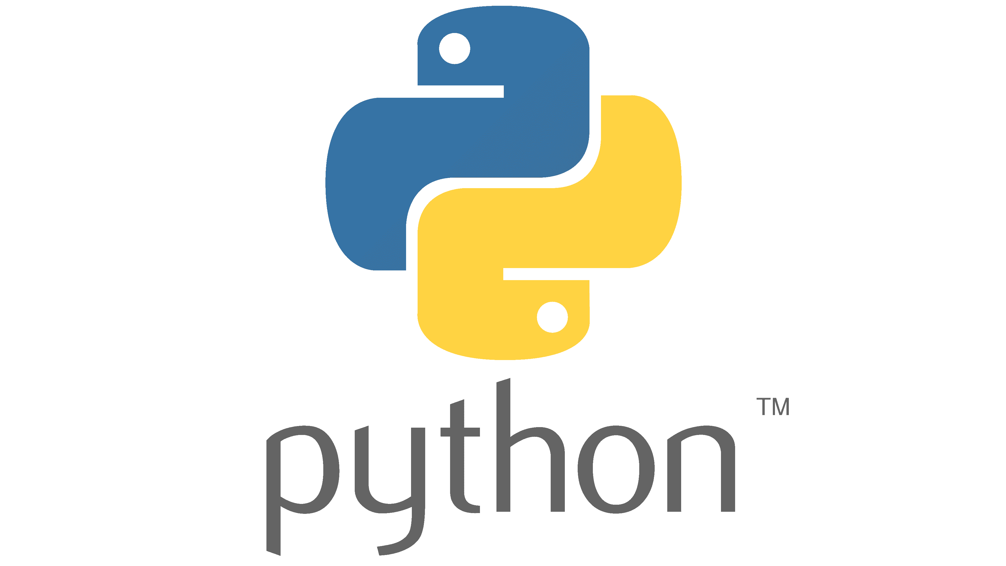

ROB 311 – Lab 7
Today, we will learn about git and python!
ROB 311

Slide 3
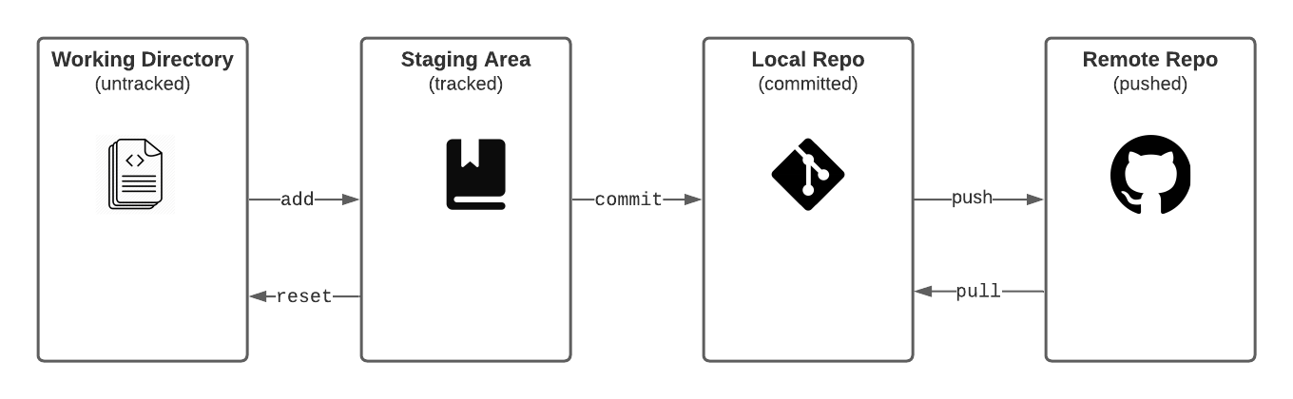
ROB 311 – Git
What is git?
Git is a free and open source distributed version control system
What is version control (VC)?
VC saves and tracks changes to source code
How do we use git?
Track changes (choose the files we want to save)
Commit changes (save the files)
Push/pull changes (send saved files to the cloud)
ROB 311

Slide 4
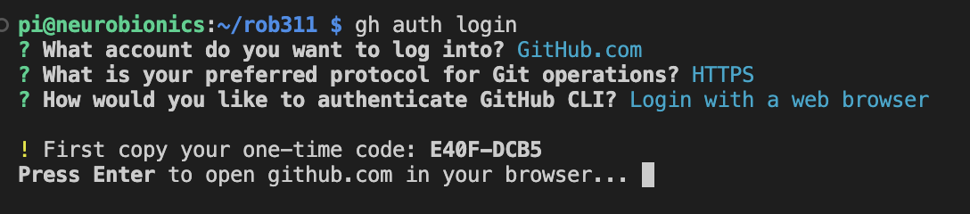
ROB 311 – Git Auth
gh auth login
Navigate through the command line prompts
Choose HTTPS and login with your browser
Now the RPi is setup with your github credentials and you will be able to clone, commit, push, and pull your private and public repositories without entering your credentials.
ROB 311

Slide 5
ROB 311 – Git Commands
Git clone – makes a copy of a repository (repo)
Git status – informs you which files are tracked, modified, deleted, etc.
Git add – adds (stage) files to be saved (committed)
Git reset – unstage changes
Git commit (-m) – saves changes to tracked files
-m: allows you to write a message on the command line
Git push origin main – send committed changes to the cloud
Git pull origin main – get most recent version of repo from the cloud
Git branch – make a new workflow from current version of repo
Used commonly when having multiple people working on one codebase
Git checkout – find what branch or commit you are on
ROB 311

Slide 6
ROB 311– Todays Lab
Fork “Rob311”repo on github
Go to: https://github.com/neurobionics/rob311
Go to python examples
ROB 311

Slide 7
ROB 311 – Python
What is python?
A high level computer language
Code is not written in terms of the machine operations that must be performed (aka: more user friendly)
Examples of high level languages: MATLAB, C#
How is it different from MATLAB
Free!!!
Indexing starts with 0 not 1
Importing packages
Written out logical operators (and vs &&, or vs ||)
Comments start with # not %
Indents/whitespace matters!
ROB 311

Slide 8
ROB 311 – Python Things
Lists
List index starts at 0
ex_list = [6,5,2,4] → ex_list[0] = 6
Last element in list has index -1
ex_list[-1] = 4
Append command adds elements to the end of a list
ex_list.append(32) → ex_list = [6,5,2,4,32]
Numpy – common math module
Has trignometic functions in numpy
Ex: numpy.asin(), numpy.cos(), etc.
Can save data using numpy!
numpy.savetxt('example_list.csv',ex_list, delimiter=",")
Delimiter – separates elements in .csv file with a comma
ROB 311

Slide 9
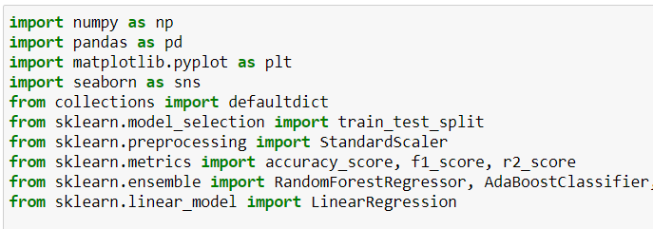
ROB 311 – Importing Modules
Importing Modules is a crucial component of writing python code!
Importing modules can be done multiple way
Import xxx
Import xxx as yy
Useful when the package has a long or non-intuitive name
From xxx import a,b,c
Useful when you don't want to import the full package
ROB 311

Slide 10
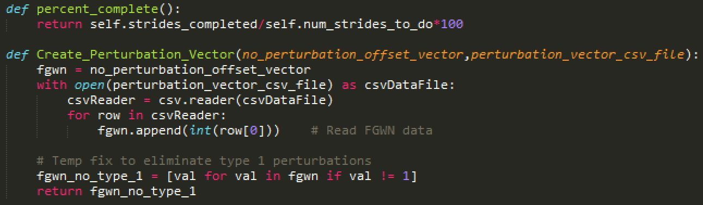
ROB 311– Creating Functions
Functions are useful for reoccurring tasks and operations
Function Example
def Function_name(input_1,input_2):
input_3 = input_1 + input_2
return input_3
def – informs python you are creating a function
return – informs python what you want the function to output
Don't forget the colon! (:)
ROB 311

Slide 11
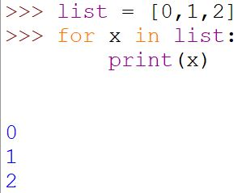
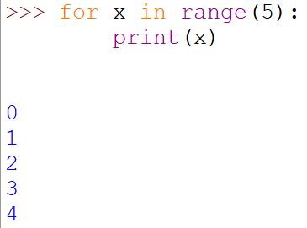
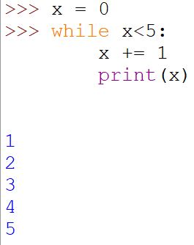
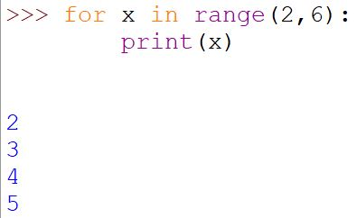
ROB 311– Looping in Python
Indentation is important!
For loop syntax
List = [0,1,2]
For x in list:
Print(x)
For x in range(5):
Print(x)
For x in range(2,6):
Print(x)
While loop syntax
x = 0
While x<5:
x += 1
ROB 311

Slide 12
ROB 311– Todays Lab
Finish “00_loop_execution.py” and “01_torque_conversion.py” scripts
Commit and push finished scripts to forked repo
Things to remember:
List.append(info_you_want_to_append)
Git status – informs you which files are tracked, modified, deleted, etc.
Git push origin main – send committed changes to the cloud
Can save data using numpy!
numpy.savetxt('example_list.csv',ex_list, delimiter=",")
ROB 311

Slide 13
ROB 311– Todays Lab
Finish “00_loop_execution.py” and “01_torque_conversion.py” scripts
Commit and push finished scripts to forked repo
Things to remember:
List.append(info_you_want_to_append)
Git status – informs you which files are tracked, modified, deleted, etc.
Git add – adds (stage) files to be saved (committed)
Git reset – unstage changes
Git commit (-m) – saves changes to tracked files
Git push origin main – send committed changes to the cloud
Can save data using numpy!
numpy.savetxt('example_list.csv',ex_list, delimiter=",")
ROB 311

